Slide 1



Disability Services
Division of Student Affairs
Karina Mason Rorris
Director – EIT Coordinator
(208) 282-1272
karinarorris@isu.edu

Slide 2
Presentation Goals
Orientation to DS
DS Responsibilities
DS Partnerships
Accommodation Process
Non Compliance
DS Projects

Slide 3

Our Mission……
To increase access to all programs and services sponsored or funded by Idaho State University

Slide 4

Creating Equal Access
Removing Barriers

Slide 5

Departmental Responsibilities
Accommodations
Employees, Students & Visitors
Occupational Therapy
Counseling/Rehabilitation Counseling Academic Coaching Program
Transition Activities & Programs
EIT & Facilities Accessibility
Notes:
Provide accommodations for all students, faculty, staff, visitors

Slide 6
Numbers Students Served
Example:
Fall 2013 – 241
Fall 2024 – 702
Notes:
Hundreds of employees

Slide 7

DS Partnership with Title IX
Additionally, Disability Services provides support services for pregnant and parenting students (who have given birth within 6 months) under Title IX of the Education Amendments Act of 1972 .
Notes:
Many partnerships
Equity & Inclusion
Facilities
IT
ITRC
Dean of Students Office

Slide 8

Academic Coaching
Provided assistance with soft skills
  Communication
  Time Management
  Problem Solving
  Organization
  Stress Management
  Attendance
  Assignment Completion
  Seeking Support Services

Slide 9
Disability
A condition that substantially limits a major life activity (ADA, Federal Law).
  Examples:
    Visual Impairment or Blind
    Hard of Hearing or Deaf
    Mental Health Conditions
    Intellectual Disability
    Learning Disability
    Acquired Brain Injury
    Physical and Mobility Impairments
Notes:
Must follow Federal & State Laws
ADAAA
504 of the Rehabilitation Act

Slide 10
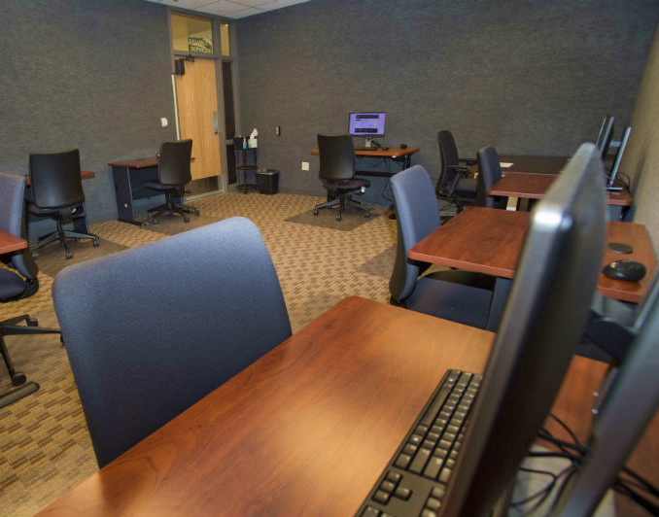


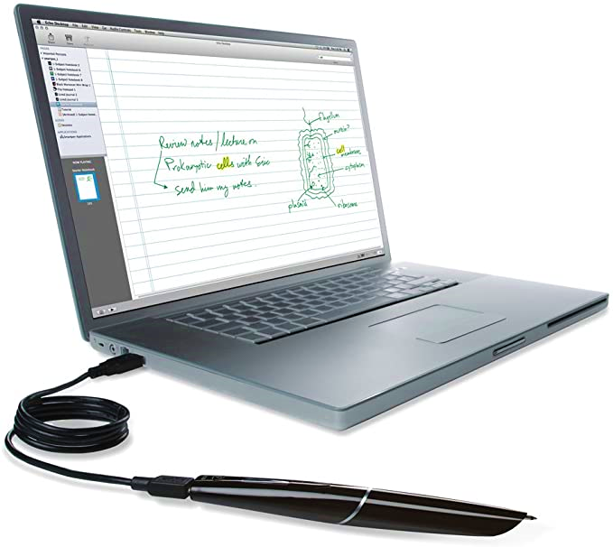
Accommodations
Notes:
Some requests might fundamentally alter the course, program, what is being measured, an accreditation standard, some law tied to profession etc.
“No penalty for spelling”
“Not having to deliver presentations”

Slide 11
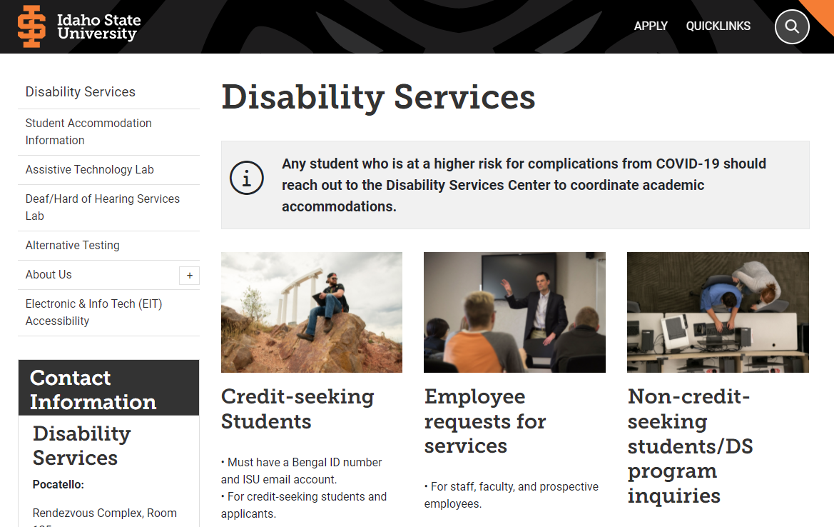
isu.edu/disabilityservices
Notes:
Karina
Apply for accommodations – student must initiate this process
Self-disclose disability and initiate the process
Once your application is in – contact us to schedule an intake (review documentation, explore eligibility and discuss next steps)
Documentation –

Slide 12
Non Compliance/Issues
Flex Agreement Response Rate
Sent Out 914
Received 346
37% return rate
Total classes – 5081
Courses with Flex make up 18% of all classes
Notes:
Why our partnership is important
This week we are pulling a report and will compare with our flex report and will generate agreements to the best of our ability

Slide 13
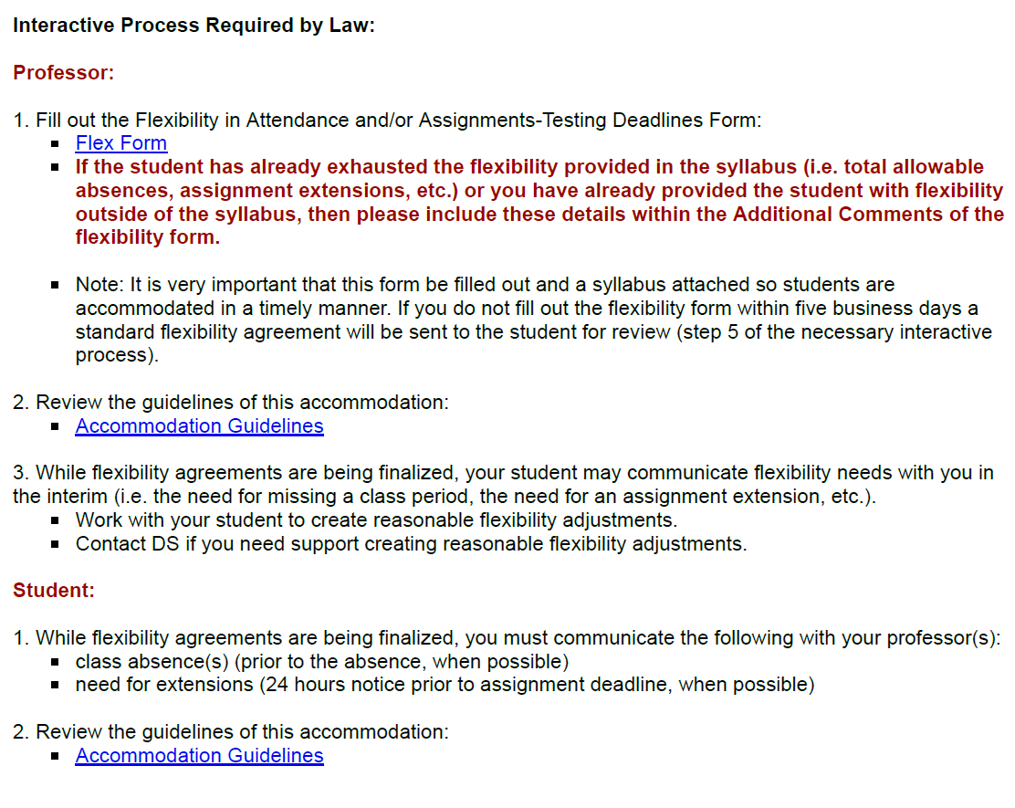
Accommodation Letter Example

Slide 14
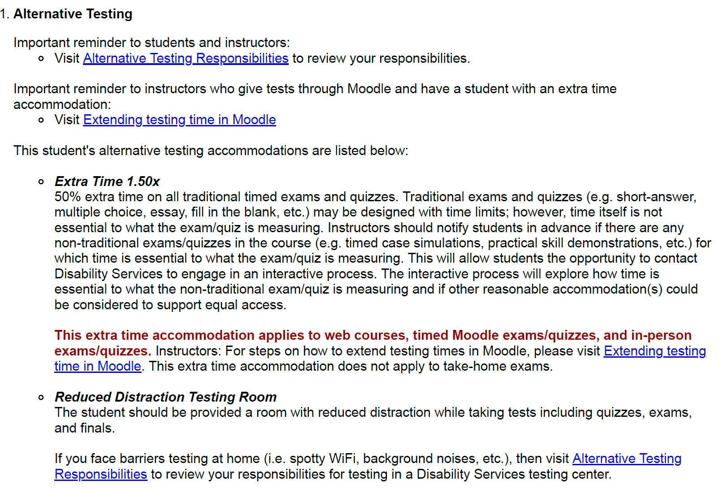
Accommodation Letter Example – Testing

Slide 15
DS Projects 2025/2026
Filling DS Coordinator Position – Meridian Campus – Spring 2025
Caseload Management System Upgrades – Fall 2025
Launch Employee Accommodation Module – Spring 2025
Develop policy for employee accommodations - TBD
Address Title II changes/EIT Committee – Spring 2025
Establish Accessibility Center – Spring 2026
Training for new DS staff - Immediately
Faculty Training - Ongoing

Slide 16

This is Why We Roar…

Slide 17

This is Why We Roar….

Slide 18
Contact Disability Services
  Pocatello (main office):
  (208) 282-3599
  disabilityservices@isu.edu
  VP for ASL: (208) 530-6505
  Rendezvous Complex, 1st Floor, Room 125
Notes:
Meridian Campus
Idaho Falls Campus

Slide 19
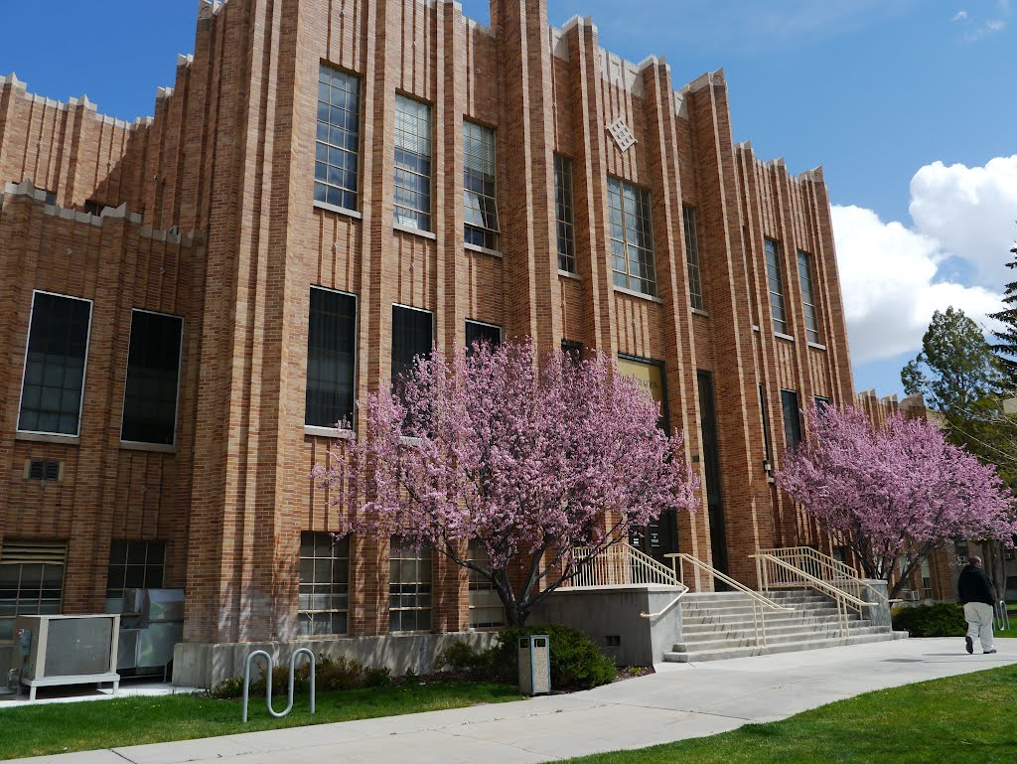
Questions?
Thank you!!!!

